Slide 1
HTML – Continued..
Instructor: Manu Peethambar
E-mail: cm13055@umbc.edu
Telegram handle: @manupeethambar888
Slides: https://github.com/manupeethambar888/webdev

Slide 2
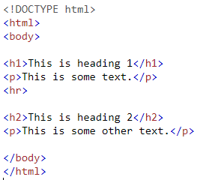
HTML Horizontal Rules
The <hr> tag defines a thematic break in an HTML page, and is most often displayed as a horizontal rule.
The <hr> element is used to separate content (or define a change) in an HTML page:

Slide 3
How to View HTML Source?
Have you ever seen a Web page and wondered "Hey! How did they do that?“
View HTML Source Code:
Right-click in an HTML page and select "View Page Source" (in Chrome) or "View Source" (in IE), or similar in other browsers. This will open a window containing the HTML source code of the page.
Inspect an HTML Element:
Right-click on an element (or a blank area), and choose "Inspect" or "Inspect Element" to see what elements are made up of (you will see both the HTML and the CSS). You can also edit the HTML or CSS on-the-fly in the Elements or Styles panel that opens.

Slide 4
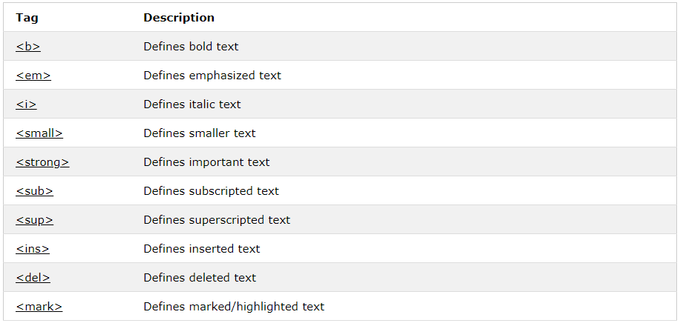
HTML Text Formatting
HTML also defines special elements for defining text with a special meaning.
Practice: https://www.w3schools.com/html/html_formatting.asp

Slide 5
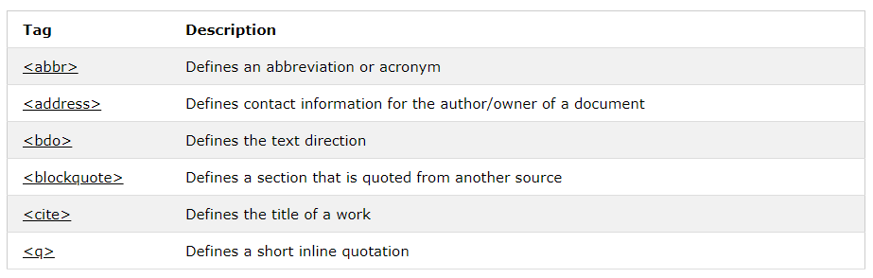
HTML Quotation and Citation Elements
Practice: https://www.w3schools.com/html/html_quotation_elements.asp

Slide 6
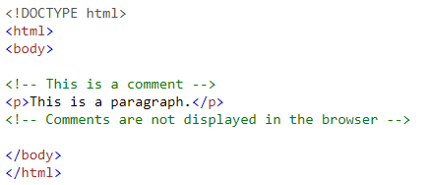
HTML Comments
Comment tags are used to insert comments in the HTML source code.

Slide 7
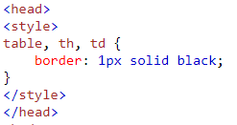
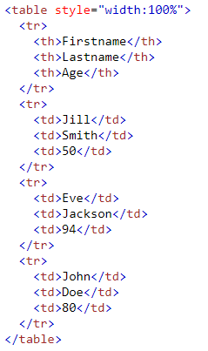
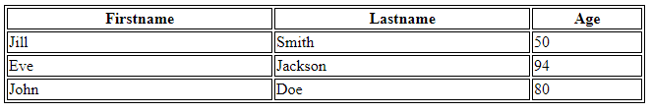
HTML Table
An HTML table is defined with the <table> tag.
Each table row is defined with the <tr> tag. A table header is defined with the <th> tag. By default, table headings are bold and centered. A table data/cell is defined with the <td> tag.

Slide 8
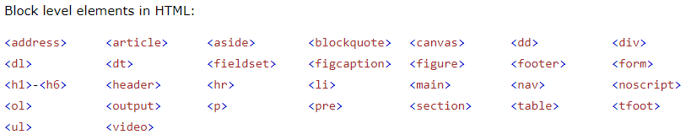
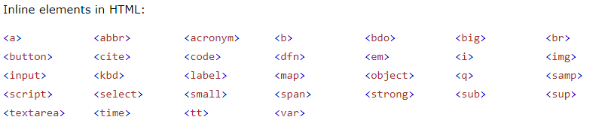
HTML Block and Inline Elements
Every HTML element has a default display value depending on what type of element it is. The default display value for most elements is block or inline.

Slide 9


Block level elements
A block-level element always starts on a new line and takes up the full width available (stretches out to the left and right as far as it can).
Inline Elements
An inline element does not start on a new line and only takes up as much width as necessary.

Slide 10
HTML Head
The HTML <title> Element
The HTML <style> Element
The HTML <link> Element
The HTML <meta> Element
Setting The Viewport:
The HTML <script> Element

Slide 11
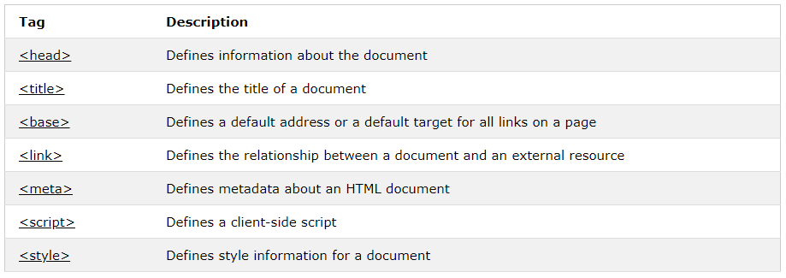
HTML head Elements
Practice: https://www.w3schools.com/html/html_head.asp

Slide 12
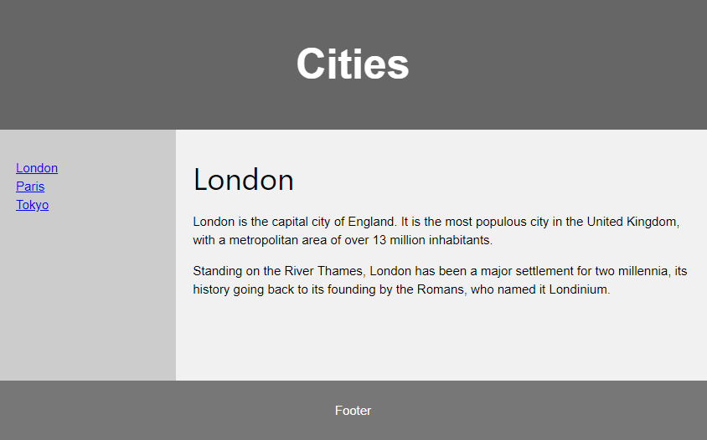
HTML Layouts

Slide 13
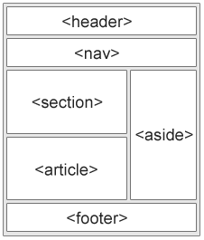
HTML Layout Elements
Websites often display content in multiple columns (like a magazine or newspaper).
HTML5 offers new semantic elements that define the different parts of a web page:
<header> - Defines a header for a document or a section
<nav> - Defines a container for navigation links
<section> - Defines a section in a document
<article> - Defines an independent self-contained article
<aside> - Defines content aside from the content (like a sidebar)
<footer> - Defines a footer for a document or a section
<details> - Defines additional details
<summary> - Defines a heading for the <details> element

Slide 14
Assignment Rules
Turn in your assignments before the class!
Name your assignments according to what is mentioned in sildes:
For example: “Assignment1.html”, “Assignment2.html”, etc.
Class work is different from home work: DO NOT MERGE BOTH
Check assignments before submitting them on browsers if it is working.
Whatever is in your GitHub assignment folder is what you upload.
Create 2 folders called Classwork and Homework.
Make sure you commit changes and push them to your repository.
Your files should be available in: https://github.com/yourusername

Slide 15
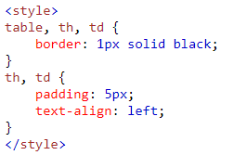
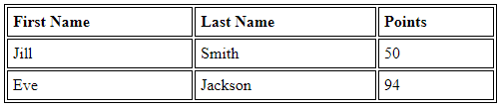
Assignment 5 due – 7/2/2018
Create a sample html file:
Create the table below using the given style.
Save this as “assignment5.html” and in your repository “Assignments_yourname” in the Homework folder.
Commit and push the changes to the repository.

